Slide 1
菌群知识库

Slide 2
文献搜索
搜索pubmed中研究菌群与精神神经疾病的相关文献

Slide 3
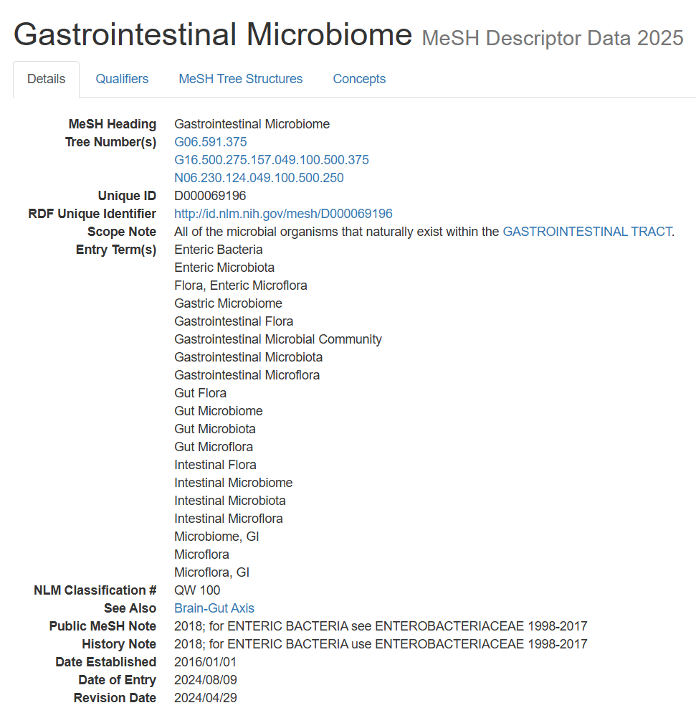
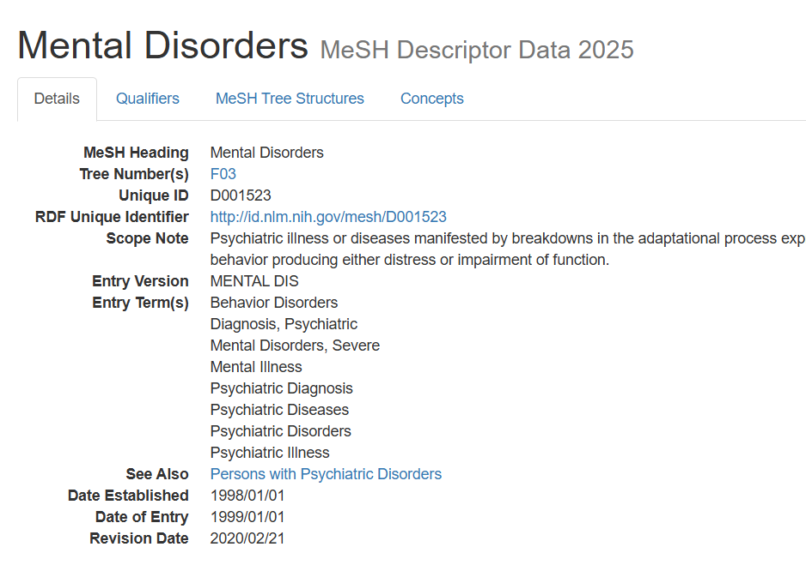
第一步：根据关键词搜索医学医学主题词
https://meshb.nlm.nih.gov/

Slide 4
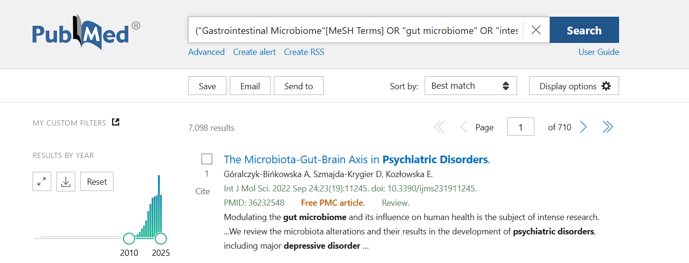
第二步：Pubmed搜索到7098条记录
("Gastrointestinal Microbiome"[MeSH Terms] OR "gut microbiome" OR "intestinal microbiota" OR "gut flora") AND ("Mental Disorders"[MeSH Terms] OR "psychiatric disorders" OR "neurological disorders" OR "neuropsychiatric disorders" OR depression OR anxiety OR schizophrenia OR autism OR Parkinson's OR Alzheimer's) NOT review[pt]

Slide 5
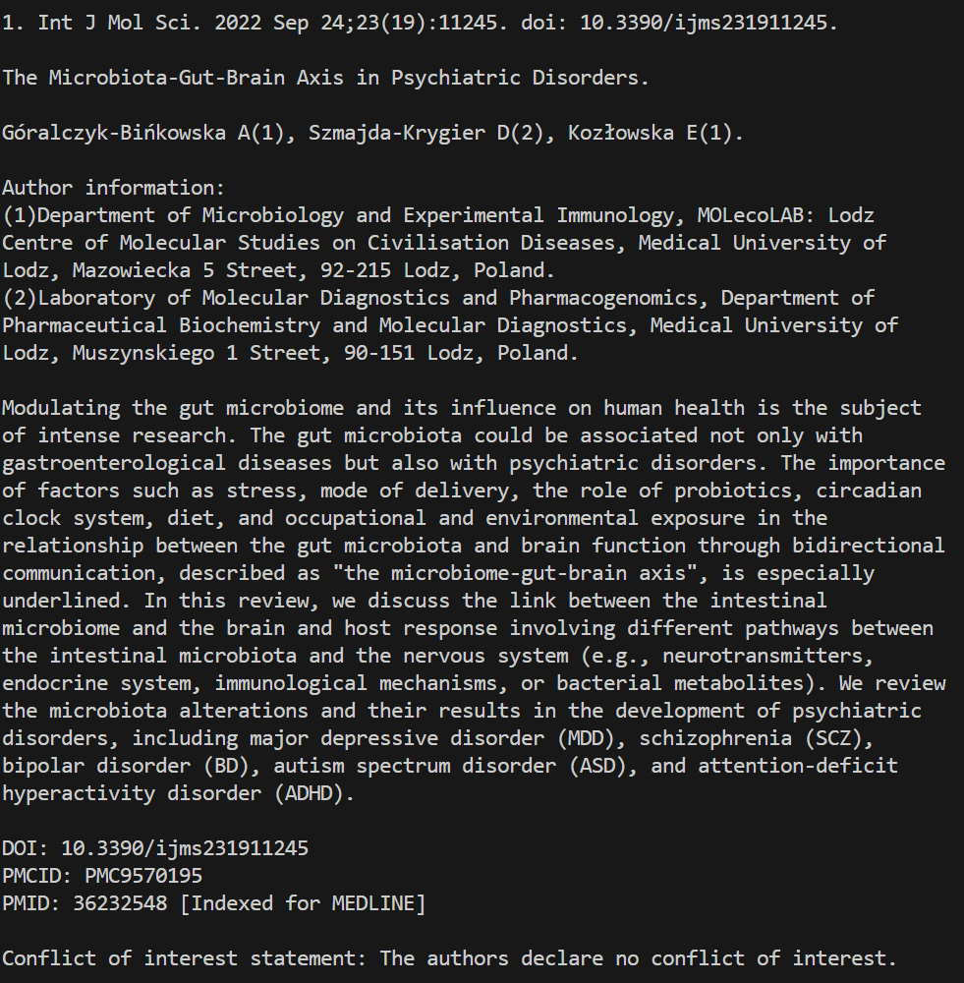
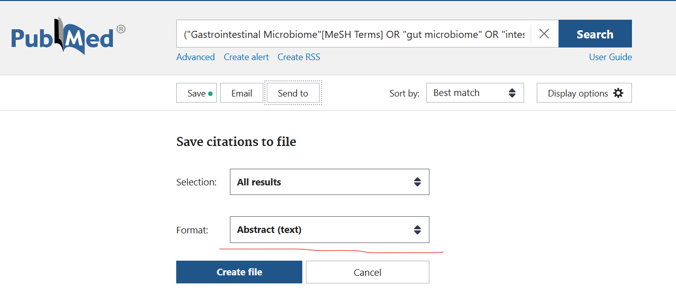
第三步：下载文献
文章全文可从pubmed的api下载，过程较为复杂
这里先简单从网页下载所有文献的摘要，以评估后续方法的可行性
文章摘要格式
文件大小为20M

Slide 6
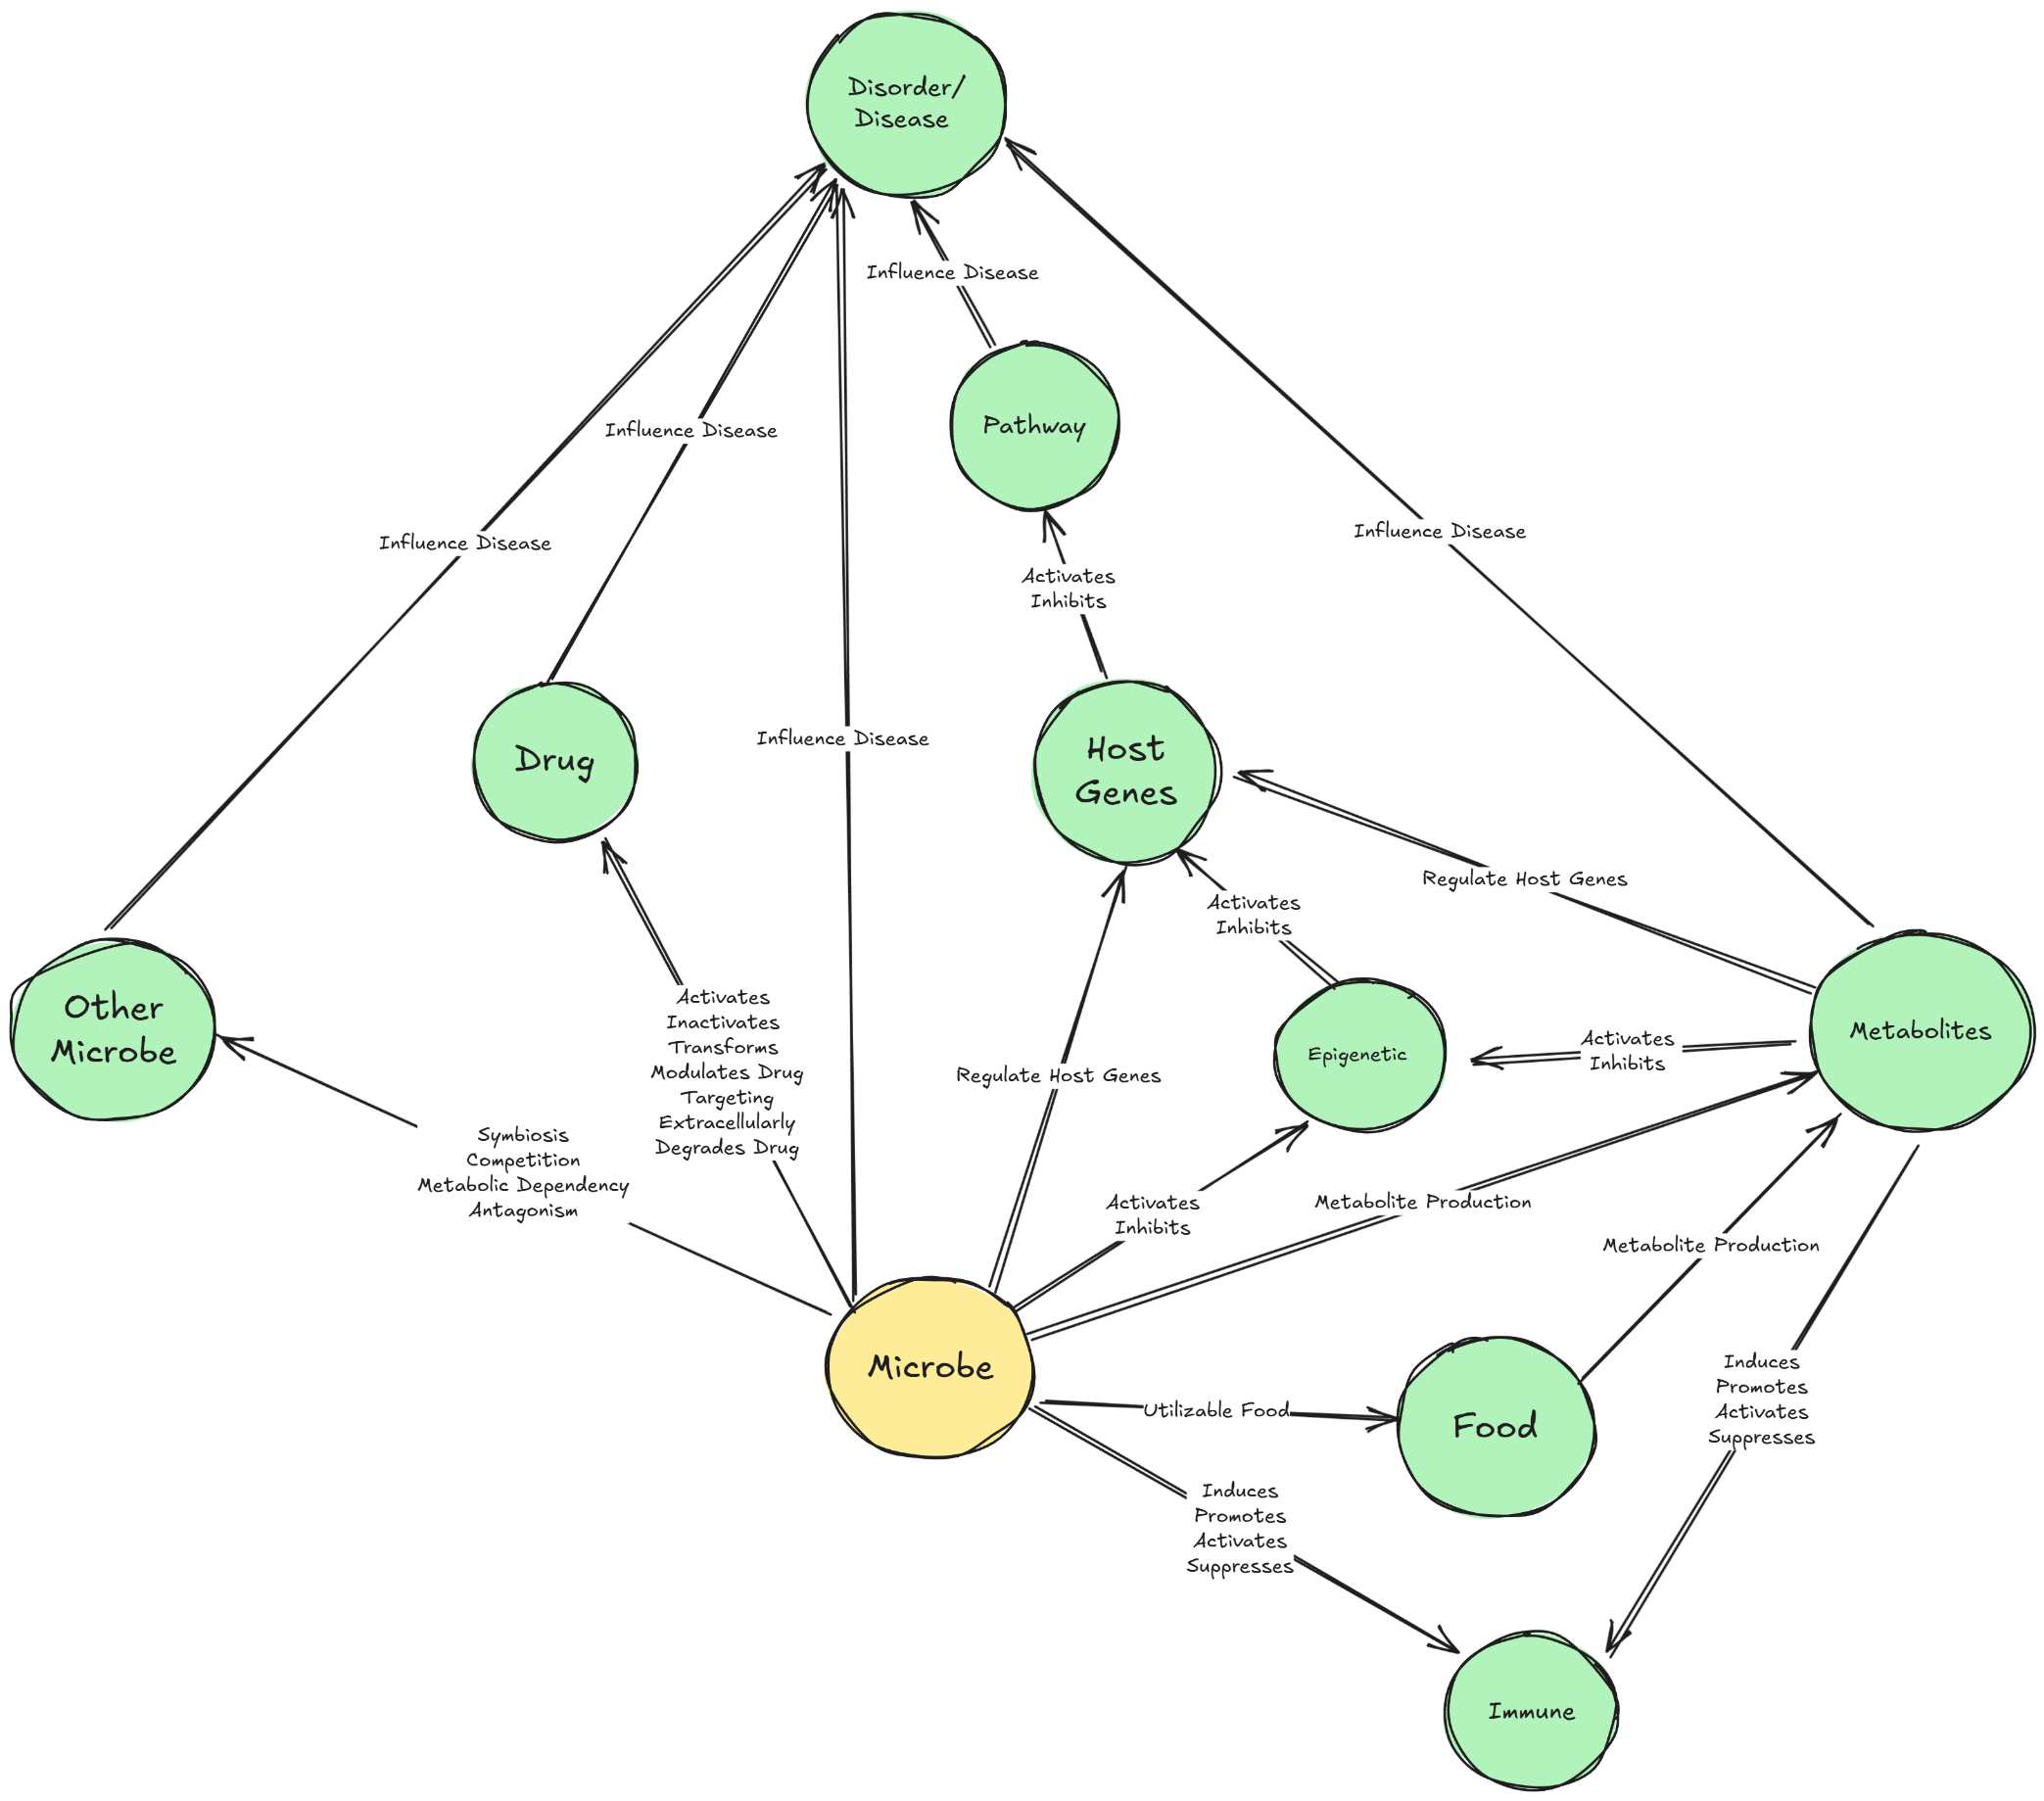
知识内容范围

Slide 7
知识内容范围描述
菌群分类信息（Taxonomy/ Microbe）：界、门、纲、目、科、属、种。
菌群与宿主疾病的关系（Disease/ Disorder Association）：菌群促进或抑制疾病的发生发展。
菌群与食物的关系: 哪些食物可以被哪些菌利用，产生什么代谢物。
菌群代谢物（Metabolites）：菌产生某一代谢物。
菌群代谢物与疾病的关系：菌群代谢物促进或抑制疾病的发生发展。
菌群代谢物与宿主基因的关系：哪些宿主相关基因可以被某个菌的某个代谢物调控。
菌群与宿主基因的关系：哪些宿主相关基因可以被某个菌调控。
菌群与免疫的关系（Immune Association）：哪些菌可以使宿主产生免疫反应。
菌群代谢物与免疫的关系：哪些菌群代谢物可以使宿主产生免疫反应。
药物与菌群相互作用（Drug-Microbiome Interaction）：哪些药物可以被哪些菌活化、灭火、转化、靶向调节、外泌酶解
菌群生态网络（Microbial Interaction Network）：物种间相互作用（如共生、竞争、拮抗、代谢依赖）
菌群数据集与文献（Omics Dataset + Publications）：数据支持，在不同的表型中，菌的丰度比较

Slide 8
第一步：构建命名实体识别训练数据集
下载存在的命名实体识别数据集，例如医学实体识别数据集
（https://huggingface.co/datasets/ktgiahieu/maccrobat2018_2020）
人工手动标注数据集

Slide 9
数据格式设计
{
"tokens": ["Autism", "spectrum", "disorder", "(", "ASD", ")"],
"labels": ["B-DISEASE", "I-DISEASE", "I-DISEASE", "O", "B-ABBR", "O"],
"relations": [
{"head": 0, "tail": 1, "type": "Abbreviation"}
]
}

Slide 10
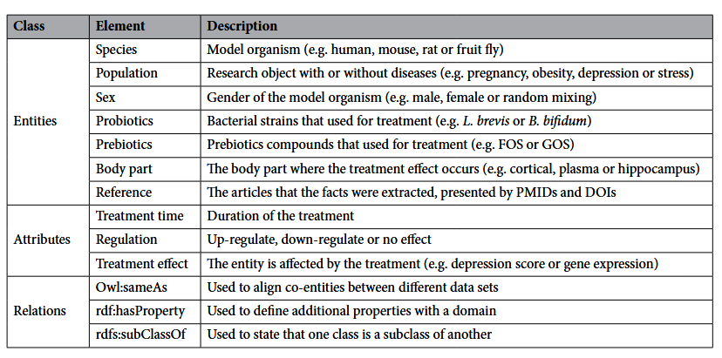
第二步：实体关系标注
extracted entities, attributes and relations
Oral administration of Lactobacillus (L.) rhamnosus for 8 weeks reduced depression scores in patients with depressive disorder
Entities
  species: human
  population: depressive disorder
  probiotics: L. rhamnosus
Attributes
  treatment time: 8 weeks;
  regulation: down;
  treatment effect: depression score
Towards a knowledge graph for pre-/probiotics and microbiota–gut–brain axis diseases

Slide 11
claim detection / scientific statement detection 模型

Slide 12
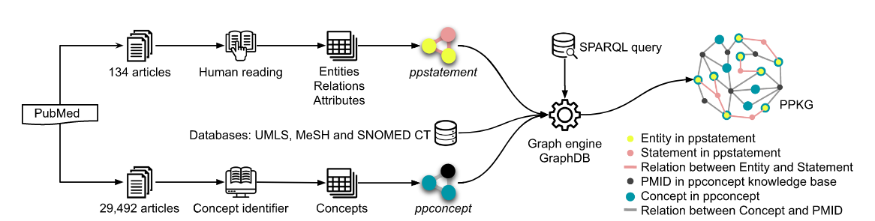

Slide 13
In microbiome–neuropsychiatric research, extracting structured knowledge from biomedical literature is essential for elucidating the complex interactions between gut microbial communities and mental health outcomes. Three major paradigms are commonly employed for this task. Multi-label sequence labeling models extend the traditional BIO tagging scheme by assigning multiple, parallel label sequences to the same token stream, enabling simultaneous annotation of biomedical entities (e.g., microbial taxa, host phenotypes) and relation triggers (e.g., “influence on”, “associated with”). This approach leverages sequence models such as BiLSTM-CRF or BERT-CRF to jointly optimize multiple tagging tasks. Span-based models represent entities and relation triggers as contiguous spans defined by their start and end indices in the token sequence, allowing direct prediction of span boundaries and semantic types. This framework is particularly effective for microbiome literature, where relations may be expressed through multi-word triggers or embedded in complex syntactic structures. Triple-based models explicitly cast the extraction process as the identification of subject–relation–object triples, linking microbial entities and host phenotypes via a relation span or type. This paradigm is naturally aligned with microbiome knowledge graph construction, supporting the integration of extracted findings into structured resources for systematic analysis. Together, these approaches provide complementary strategies for capturing intricate entity–relation patterns in biomedical text, thereby facilitating large-scale knowledge discovery in gut–brain axis research.

